Slide 1
Cloud Platform Programming H9CPP

Slide 2
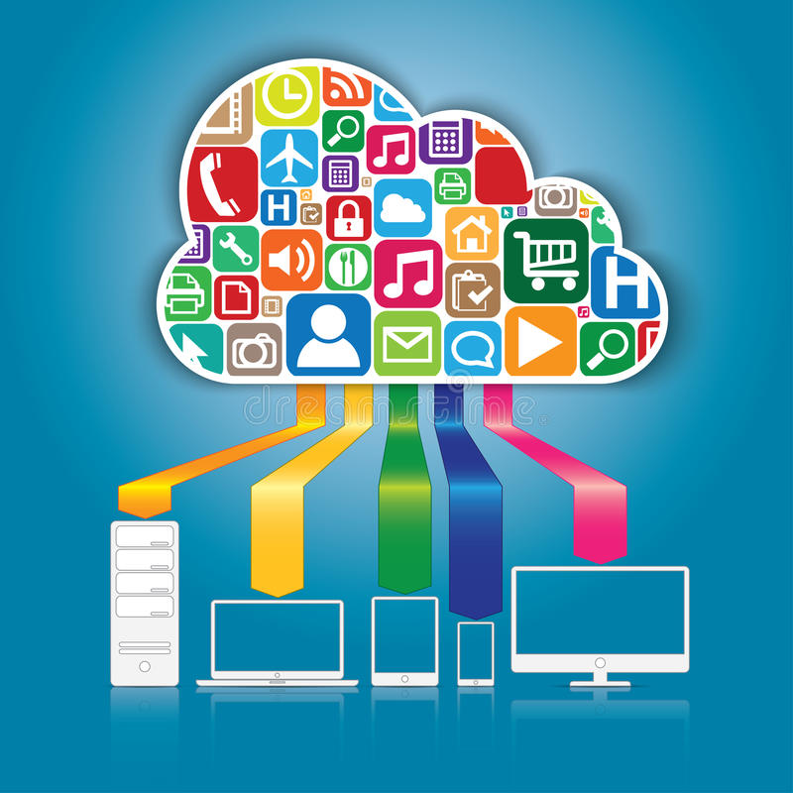
What is Cloud Computing?
C – Computing resources
L - Location
O - Online
U – Utility
D - Demand

Slide 3

NIST Definition
Cloud computing is a model for enabling convenient, on-demand network access to a shared pool of configurable computing resources (e.g., networks, servers, storage, applications, and services) that can be rapidly provisioned and released with minimal management effort or service provider’s interaction.

Slide 4
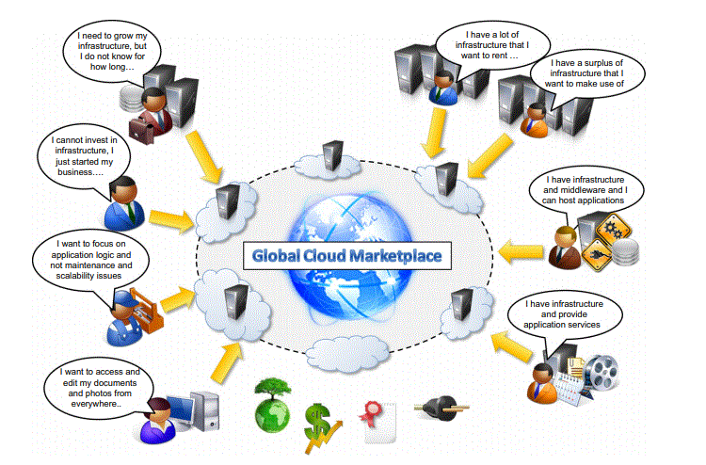
Example

Slide 5
What makes Cloud Computing Different?
No need to worry about the problems of providing multiple licenses, data loss due to virus or backup issues or rolling upgrades of servers.
Your data is, where the internet is.

Slide 6
Cloud Computing
The idea of cloud computing is based on a very fundamental principal of “reusability of IT capabilities”.
Cloud Computing refers to manipulating, configuring, and accessing the applications online. It offers online data storage, infrastructure and application.
Major corporations including Amazon, Google, IBM, Sun, Cisco, Dell, HP, Intel, Novell, and Oracle have invested in cloud computing and offer individuals and businesses a range of cloud-based solutions.

Slide 7
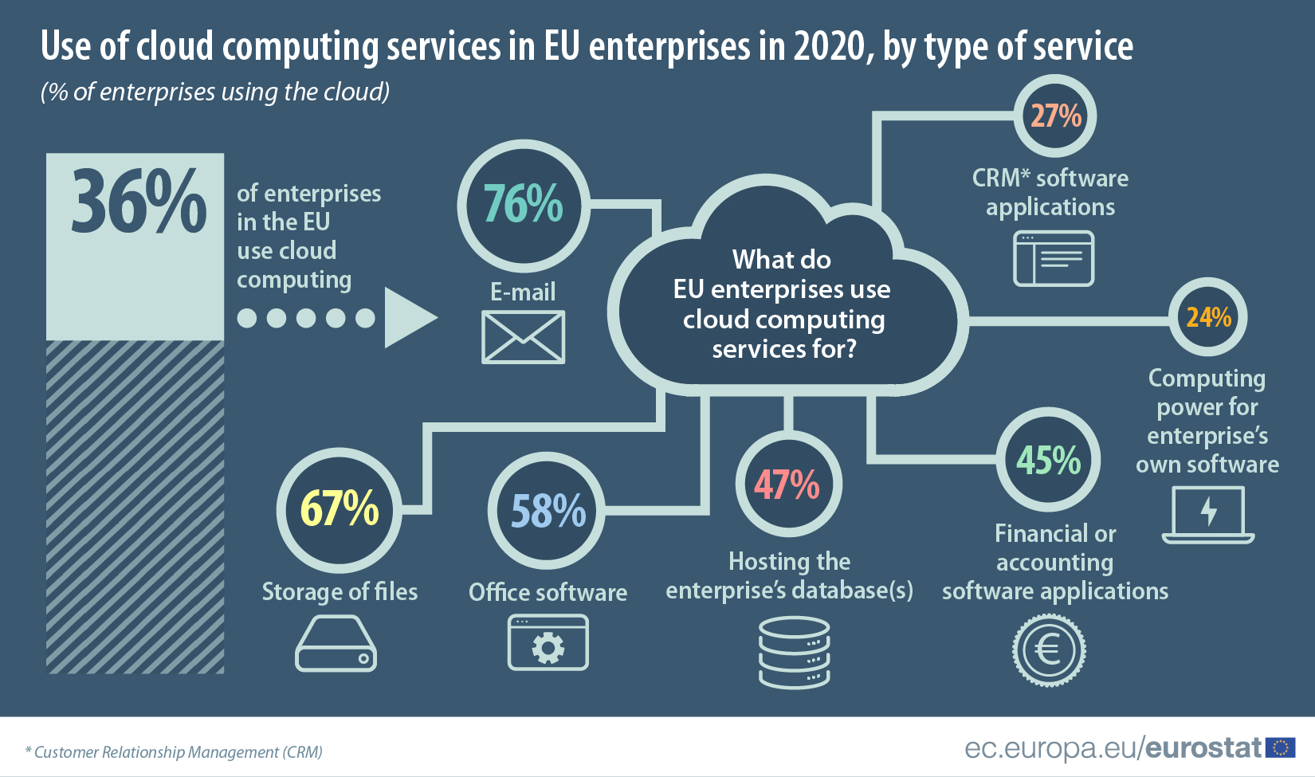
Cloud Computing

Slide 8
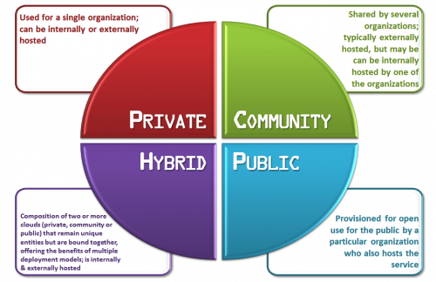
Deployment models

Slide 9
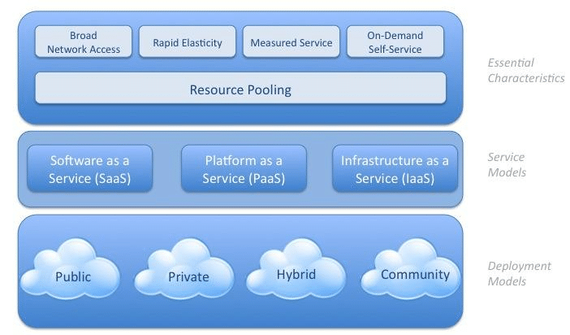
Cloud Architecture - NIST
Fig: Architecture of Cloud Computing by NIST

Slide 10
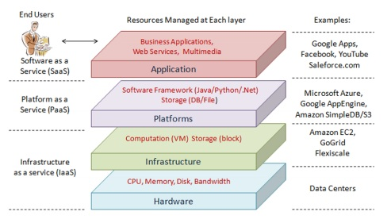
Cloud Architecture
Fig: Architecture of Cloud Computing

Slide 11
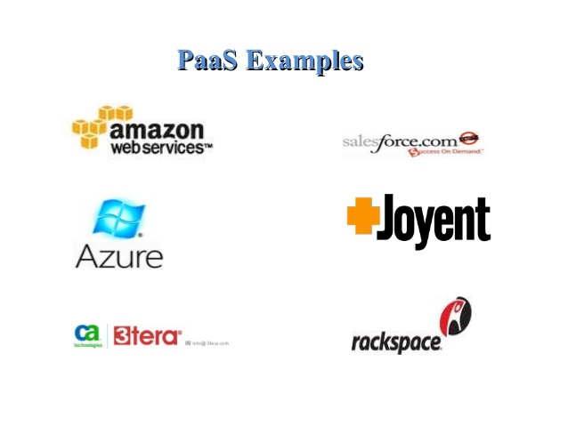
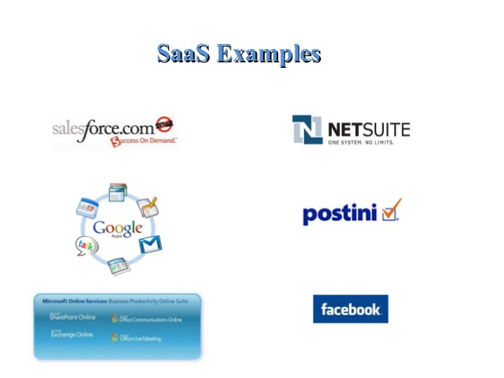
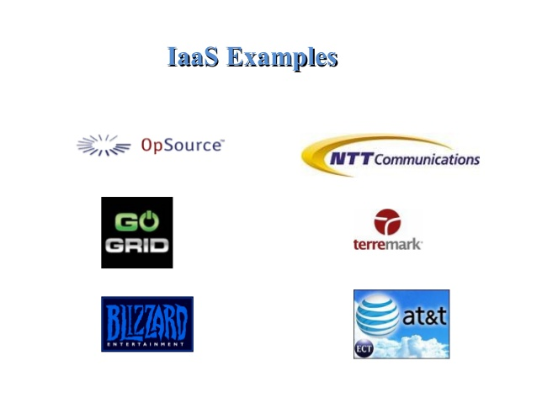
Service Models
Platform-as-a-Service (PaaS) is a set of software and development tools hosted on the provider’s servers.
This offers an integrated set of developer environment that a developer can tap to build their applications without having any clue about what is going on underneath the service.
Software-as-a-Service (SaaS) is a software distribution model in which applications are hosted by a service provider and are made available to customers over a network.
It is also associated with a pay-as-you-go subscription licensing model.
Infrastructure as a service (IaaS) is a single tenant cloud layer where the Cloud computing vendor’s dedicated resources are only shared with contracted clients at a pay per use fee.
This greatly minimizes the need for huge initial investment in computing hardware such as servers, networking devices and processing powers.

Slide 12
Service Models
The world is changing, quickly and fast; and to adapt to these growing changes, businesses are experiencing unprecedented stress on maintaining a robust and cost-effective IT Infrastructure. But thanks to Cloud Computing and its various service models – Saas, IaaS, Paas, businesses now have the option to move beyond on-premise IT Infrastructure for improved processing and storage capacity.
IaaS, PaaS and SaaS are the three most popular types of cloud service offerings. (They are sometimes referred to as cloud service models or cloud computing service models.)

Slide 13
Service Models
'As a service' refers to the way IT assets are consumed in these offerings - and to the essential difference between cloud computing and traditional IT. In traditional IT, an organization consumes IT assets - hardware, system software, development tools, applications - by purchasing them, installing them, managing them and maintaining them in its own on-premises data center.
In cloud computing, the cloud service provider owns, manages and maintains the assets; the customer consumes them via an Internet connection, and pays for them on a subscription or pay-as-you-go basis.
So, the chief advantage of IaaS, PaaS, SaaS or any 'as a service' solution is economic: A customer can access and scale the IT capabilities it needs for a predictable cost, without the expense and overhead of purchasing and maintaining everything in its own data center.
But there are additional advantages specific to each of these solutions.

Slide 14
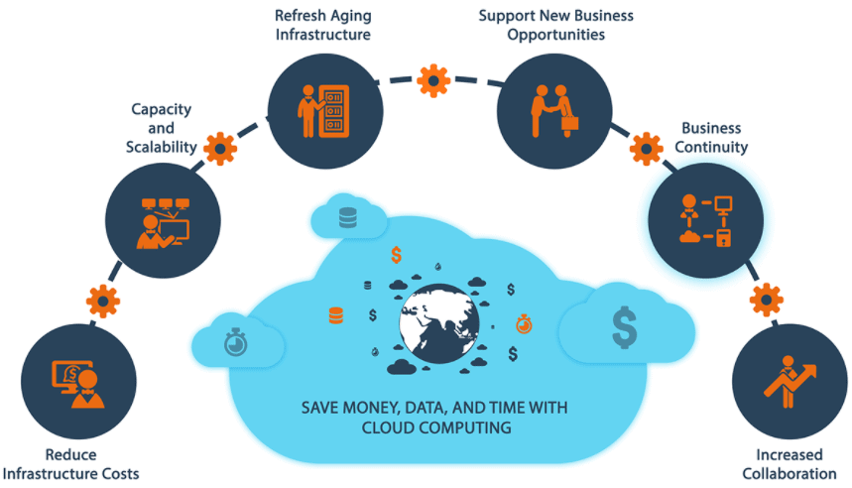
Characteristics Of Service Model of cloud computing

Slide 15
Characteristics Of Service Model of cloud computing
Multi-Tenant: Multi-tenancy is an architecture in which a single instance of a software application serves multiple customers. Each customer is called a tenant.
Self-Sevice: Self-service cloud computing is a private cloud service where the customer provisions storage and launches applications without an external cloud service provider. With a self-service cloud, users access a web-based portal to request or configure servers and launch applications.
Elastic (Scale-Up | Scale-Down): Elasticity is the ability to grow or shrink infrastructure resources dynamically as needed to adapt to workload changes in an autonomic manner, maximizing the use of resources. This can result in savings in infrastructure costs overall.
Web-Based: It means you can access your resources via Web-Based applications.
Automated: Most of the things in the Cloud are automated, and human intervention is less.
Pay As You Go Model: You only have to pay when utilizing cloud resources.
Modern Web-Based Integration: It allows you to configure multiple application programs to share data in the cloud. In a network that incorporates cloud integration, diverse applications communicate either directly or through third-party software.
Secure: Cloud services create a copy of the data that you want to store to prevent any form of data loss. If one server loses the data by any chance, the copy version is restored from the other server.

Slide 16
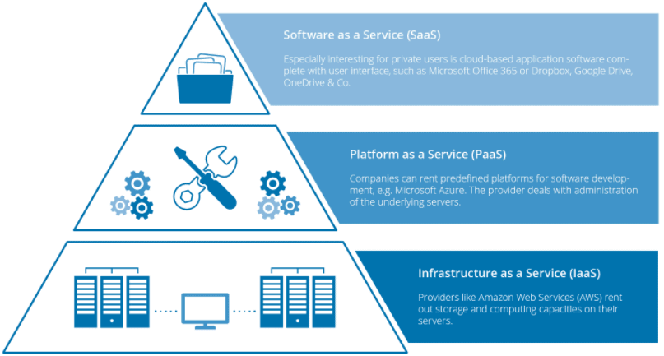
Service Models

Slide 17
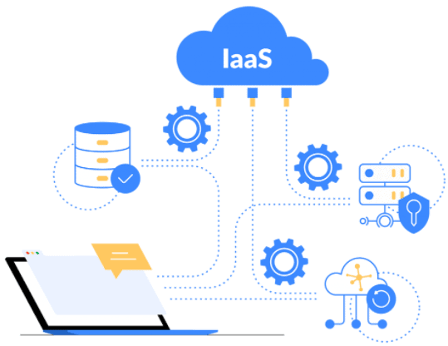
IaaS
Infrastructure As A Service (IaaS)
It is the most flexible type of cloud service which lets you rent the hardware and contains the basic building blocks for cloud and IT.
It gives complete control over the hardware that runs your application (servers, VMs, storage, networks & operating systems).
It’s an instant computing infrastructure, provisioned and managed over the internet.
IaaS gives you the very best level of flexibility and management control over your IT resources.
It is most almost like the prevailing IT resources with which many IT departments and developers are familiar.
Examples of IaaS: Virtual Machines or AWS EC2, Storage or Networking

Slide 18
Benefits
IaaS is an efficient and cost-effective way to deploy, operate, and scale your IT infrastructure. It’s easy to set up and configure, so you can start using it quickly. And because it’s available as a service from an external provider, you don’t have to worry about building and maintaining your own infrastructure. IaaS offers the following benefits:
Cost savings: IaaS is more cost-effective than building your own data center. You pay only for what you need — storage space, CPU power, bandwidth, and other resources. This makes it easier to scale up or down as needed.
On-demand access: You can instantly provision new resources whenever they’re needed without having to invest in new hardware and software or hire additional IT staff members. The cloud provider takes care of all the maintenance and upgrades required to keep your servers online 24/7 with 99 percent uptime guarantees (or better).
Flexibility: With cloud computing, you can easily add more resources when demand increases without having to upgrade equipment or hire more IT professionals.

Slide 19
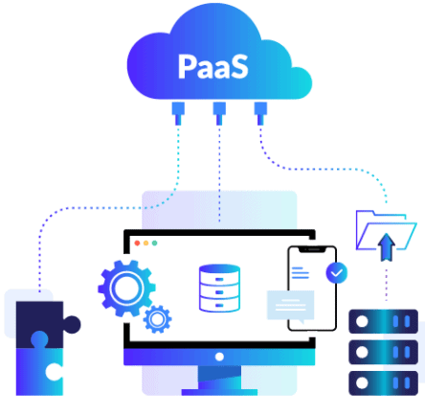
PaaS
PaaS is a cloud service model that gives a ready-to-use development environment where developers can specialize in writing and executing high-quality code to make customized applications.
It helps to create an application quickly without managing the underlying infrastructure. For example, when deploying a web application using PaaS, you don’t have to install an operating system, web server, or even system updates. However, you can scale and add new features to your services.
This cloud service model makes the method of developing and deploying applications simpler and it is more expensive than IaaS but less expensive than SaaS.
This helps you be more efficient as you don’t get to worry about resource procurement, capacity planning, software maintenance, patching, or any of the opposite undifferentiated work involved in running your application.
Examples of PaaS: Elastic Beanstalk or Lambda from AWS, WebApps, Functions or Azure SQL DB from Azure, Cloud SQL DB from Google Cloud, or Oracle Database Cloud Service from Oracle Cloud.

Slide 20
Benefits
PaaS is an easy way to build an application, and it offers a lot of benefits. Here are just a few:
Faster development time – You don’t have to build infrastructure before you can start coding.
Reduced costs – Your IT department won’t need to spend time on manual deployments or server management.
Enhanced security – PaaS providers lock down your applications so that they’re more secure than traditional web apps.
High availability – A PaaS provider can make sure your application is always available, even during hardware failures or maintenance windows.

Slide 21
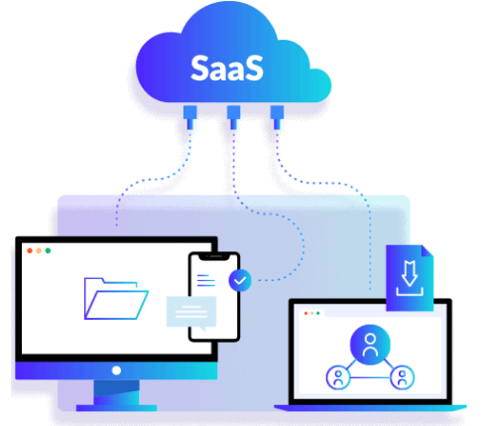
SaaS
SaaS provides you with a complete product that is run and managed by the service provider.
The software is hosted online and made available to customers on a subscription basis or for purchase in this cloud service model.
With a SaaS offering, you don’t need to worry about how the service is maintained or how the underlying infrastructure is managed. It would help if you believed how you’d use that specific software.
Examples of SaaS: Microsoft Office 365, Oracle ERP/HCM Cloud, SalesForce, Gmail, or Dropbox.

Slide 22
Benefits
The benefits of SaaS are numerous and varied. Many businesses have already made the switch to SaaS, but some are still skeptical about making the change. Here are some of the top reasons why you should consider switching to SaaS:
Lower Total Cost of Ownership: One of the biggest benefits of SaaS is that it lowers your total cost of ownership (TCO) by eliminating hardware expenses and maintenance costs. There is no longer a need to buy servers or hire IT professionals to maintain or monitor them, which results in fewer upfront costs and reduced maintenance fees over time.
Better Security: Another benefit of SaaS is improved security. Since most services are hosted on secure servers in data centers with 24/7 monitoring, there’s less chance for hackers to gain access or steal your data. This makes SaaS a more secure option for storing sensitive information than other options like on-premise software or local servers. In fact, according to Gartner’s 2017 Magic Quadrant report, “Software as a service (SaaS) offerings provide better security than self-hosted software does.”

Slide 23
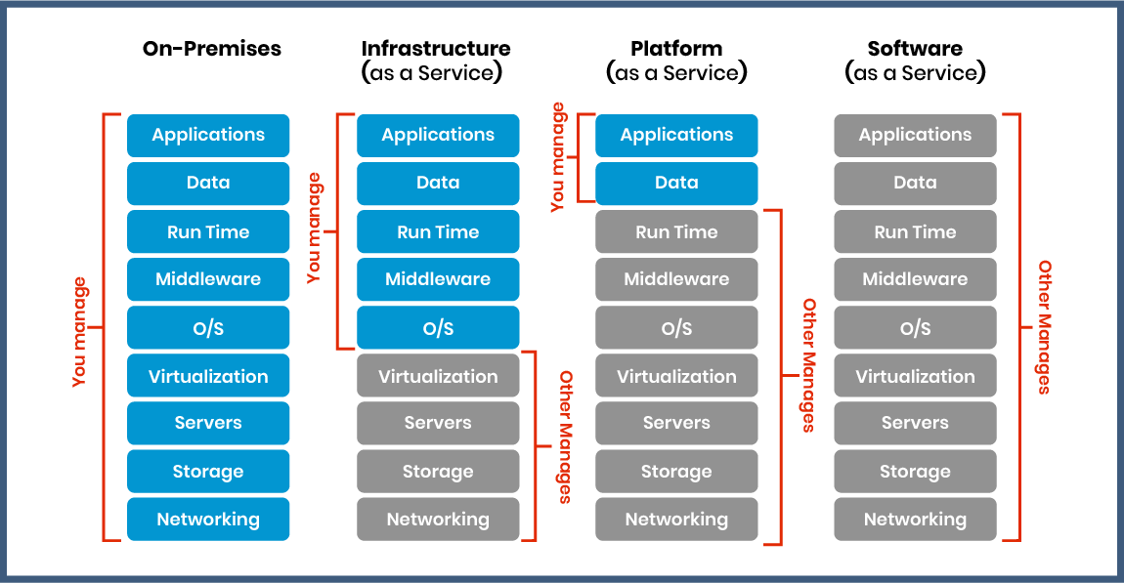
Graphical Comparison of Cloud Computing Service Models

Slide 24
Which Cloud Service Model To Learn?
One of the most common questions I get from my students is which Cloud Computing Service Model I should learn?
So, If you are System Administrator, you should learn both Infrastructures as a Service (IaaS) and Platform as a Service (PaaS). The reason is that whatever you are building or deploying is over Infrastructure as a Service, ie. PaaS always runs on top of IaaS. That’s the reason you should know both.
If you are working as a consultant such as a financial consultant or working on a packaged application such as HRMS, SAP, etc., you should learn Software as a Service (SaaS).

Slide 25
Cloud Shared Responsibility Model
A shared responsibility model is a cloud security framework that dictates the security obligations of a cloud computing provider and its users to ensure accountability.
When an enterprise runs and manages its own IT infrastructure on premises, within its own data center, the enterprise -- and its IT staff, managers and employees -- is responsible for the security of that infrastructure, as well as the applications and data that run on it. When an organization moves to a public cloud computing model, it hands off some, but not all, of these IT security responsibilities to its cloud provider. Each party -- the cloud provider and cloud user -- is accountable for different aspects of security and must work together to ensure full coverage.
While the responsibility for security in a public cloud is shared between the provider and the customer, it's important to understand how the responsibilities are distributed depending on the provider and the specific cloud model.

Slide 26
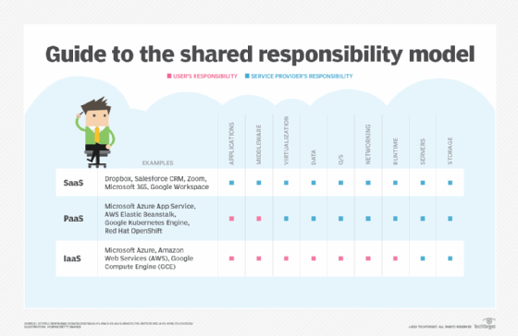
Cloud Shared Responsibility Model

Slide 27
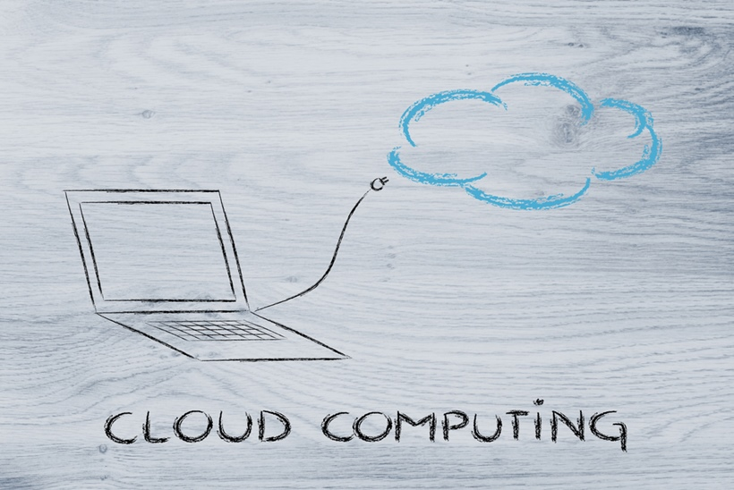
Cloud Scaling

Slide 28
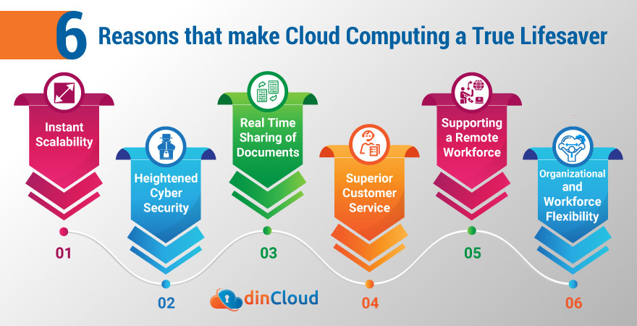

Slide 29
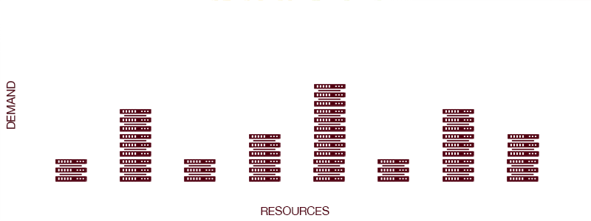

Slide 30
Introduction
A scalable system is able to increase or reduce its performance, resources and functionalities according to user’s needs.
High-scalability allows to optimize the overall efficiency of the system and get cost-savings.
Scalability is one of the key features of Cloud Computing solutions, one of the reason why Cloud has been so successful on the market and it will keep increasing.

Slide 31
How Scaling is possible?
Virtualization is what makes scalability in cloud computing possible. Virtual machines (VMs) are scalable. They’re not like physical machines, whose resources are relatively fixed.
A user can add any amount of resources to VMs at any time.
One can scale them up by:
Moving them to a server with more resources
Hosting them on multiple servers at once (clustering)

Slide 32
How Scaling is possible?
The other reason cloud computing is scalable? Cloud providers already have all the necessary hardware and software in place. Individual businesses, in contrast, can’t afford to have surplus hardware on standby.

Slide 33


Slide 34
Benefits of Scalable System
highly-customizable infrastructure according to specific customer’s needs
possibility of increasing or decreasing the system power according to the needs of the moment and the customer’s availability
scalability ensure a minimum service level even in case of failure

Slide 35
Benefits of Scalable System
Performance
Scalable architecture has the ability to handle the bursts of traffic and heavy workloads
Cost-efficient
cost implications of storage growth making scalability in the cloud very cost effective.
Easy and Quick
Scaling up or scaling out in the cloud is simpler; you can commission additional VMs with a few clicks and after the payment is processed, the additional resources are available without any delay.

Slide 36

Disadvantages
If you want a fully scalable system then you have a large task to handle. It requires planning, testing and again testing for your data storage. If you have the applications already then splitting up the system will require code changes, updates and monitoring. You have to be well prepared for the digital transformation of your infrastructure.

Slide 37
Types of scalability
Scalability
Vertical scale or scale-up
Horizontal scale or scale-out
Diagonal scaling

Slide 38
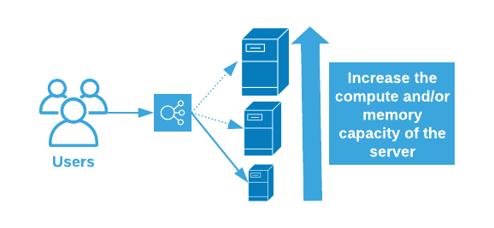
Vertical scale or scale-up
Vertical Scaling or Scaling up is easy, it can be done by moving the application to bigger virtual machines deployed in the cloud or you can scale up by adding expansion units as well with your current infrastructure.
This ability to add resources to accommodate increasing workload volumes is vertical scaling. It can resize your server with no change in your code.

Slide 39
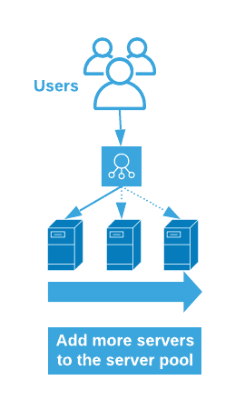
Horizontal scale or scale-out
Horizontal Scaling or Scaling out is the addition of nodes to the existing infrastructure to accommodate additional workload volumes.
The total workload volume is aggregated over the total number of nodes and latency is effectively reduced. This scaling is ideal for workloads that require reduced latency and optimized throughput.

Slide 40
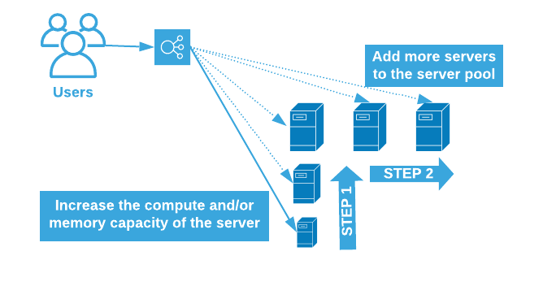
Diagonal scaling
Essentially a combination of vertical and horizontal scaling, this setup will scale vertically first until you reach a preset limit and then scale the system horizontally.

Slide 41
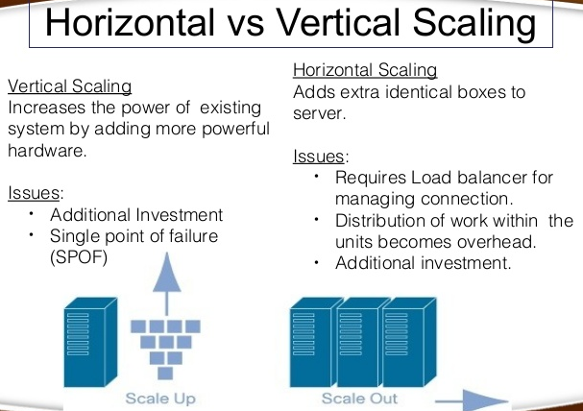
Major Difference

Slide 42
Cloud Service Providers
AWS
IAAS & PAAS
EC2 / S3 / RDS / Elastic Bean / IoT
Apple Have significant presences in CC with the iCloud – Seamless integrations. Backup & Store. Access from anywhere
Microsoft
Offers IAAS / PAAS / SAAS
Enterprise SW and Dev Tools
Office 365 – SAAS
Google Cloud Platform
Universal Cloud for Google Eco Sys
Collaboration / Storage etc
IBM Private / Public / Hybrid Models of deployments. Provides full range of PAAS / IAAS / SAAS – Pay As You Go Model for businesses.

Slide 43
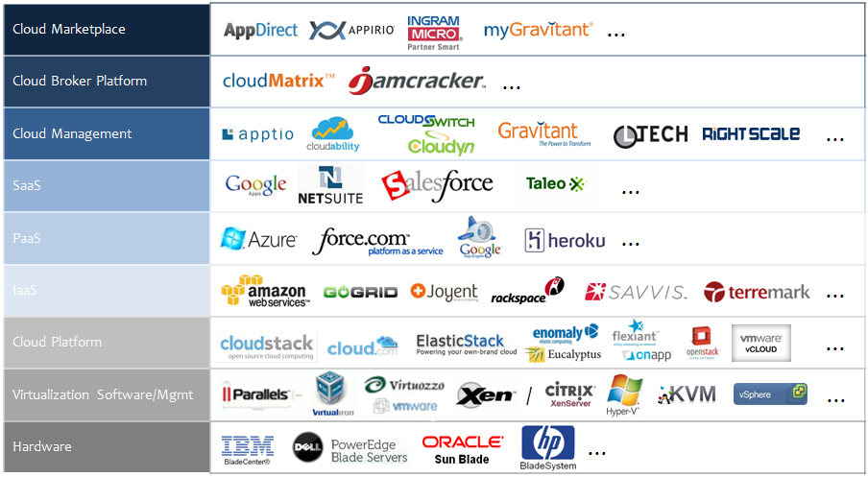
CSPs continued

Slide 44
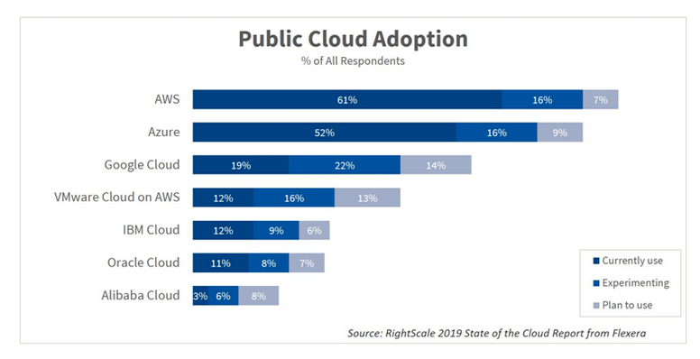
CSPs continued

Slide 45
Thank you!!

